Slide 1
Numerical integration with GeoGebra in high school
Đorđe Herceg, Dragoslav Herceg
Faculty of Sciences
University of Novi Sad, Serbia
herceg@dmi.uns.ac.rs
hercegd@dmi.uns.ac.rs

Slide 2
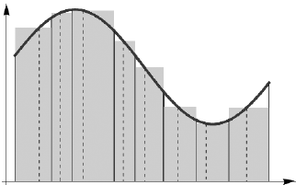
The definite integral in schools
Definite integral and its applications are studied in almost all secondary schools.
The concept of definite integral is introduced as the Riemann integral, which is defined in terms of the Riemann sum and its geometrical interpretation.

Slide 3
The Riemann sum
The partition:
Then we define:
The Riemann sum:
This condition needs to be satisfied:

Slide 4
It is not easy to grasp this concept
University courses of Numerical mathematics also contain topics based on this definition of the definite integral.
For secondary school pupils, as well as high school and university students, the definite integral defined by the Riemann sum may be hard to understand.
A more intuitive and self-explanatory approach to teaching of definite integral is what we are trying to achieve.
We want to be able to explain on the computer in exactly the same manner as we do on the board.

Slide 5
GeoGebra
We use GeoGebra for teaching, preparation of teaching materials, and we also recommend it for self study.
GeoGebra is accessible to everyone, and in version 3.2 it has many new and useful commands and tools.
Commands such as LowerSum and UpperSum can help convey the concept of the Riemann sum.
We have made tools which perform only the basic steps, not everything at once.

Slide 6
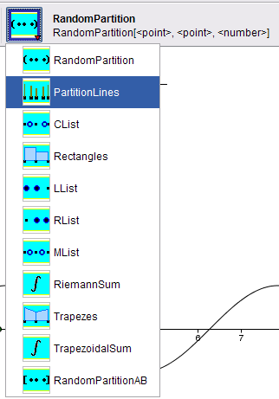
Tools for numerical integration (1)
Our tools for numerical integration fall into four categories:
Partitions (random, equidistant)
Selection of points c_{i} (random, left, middle, right)
Sums (Riemann, trapezoidal)
Graphical representation (rectangles, trapezes)
We also have simplified versions of the tools for introductory examples.
All the tools can be used independently of each other.

Slide 7
Tools for numerical integration (2)
Partition – creates an equidistant partition of a given interval
RandomPartition – creates a random partition of a given interval
CList – creates a random point in each subinterval of a partition
LList – creates points for left rectangles
MList – creates points for middle rectangles
RList – creates points for right rectangles
Rectangles – draws rectangles, given a function, a partition and c points
Trapezes – same as above, but draws trapezes instead
RiemannSum, TrapezoidalSum – calculates the appropriate sum

Slide 8
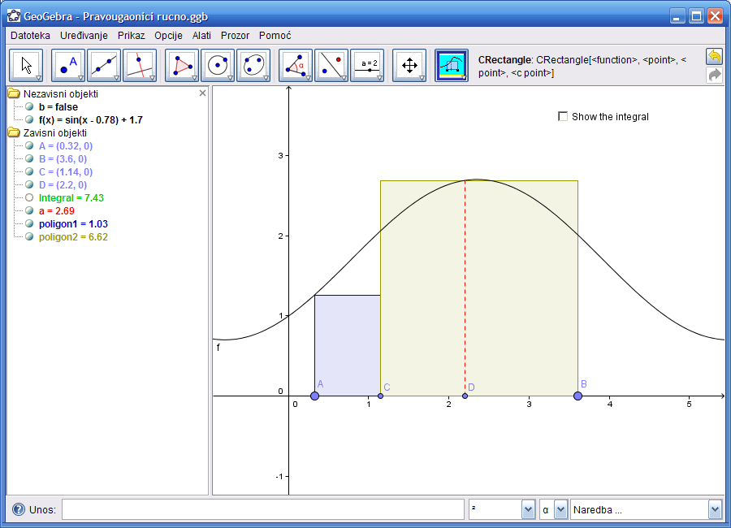
Example 1 - Introduction
We start by first introducing the partitioning of the interval and then placing some rectangles on it.

Slide 9
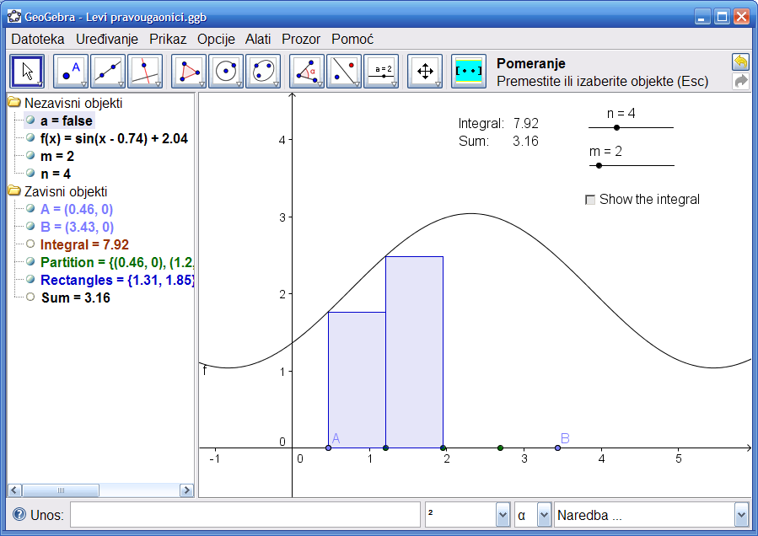
Example 2
In this example we compare the left rectangles to the ‘exact’ value of the integral. We can change the number of partition points.

Slide 10
Example 3 - Simpson’s rule
Unfortunately, certain limitations of the current version of GeoGebra prevented us from fully implementing the tools for Simpson’s rule.

Slide 11
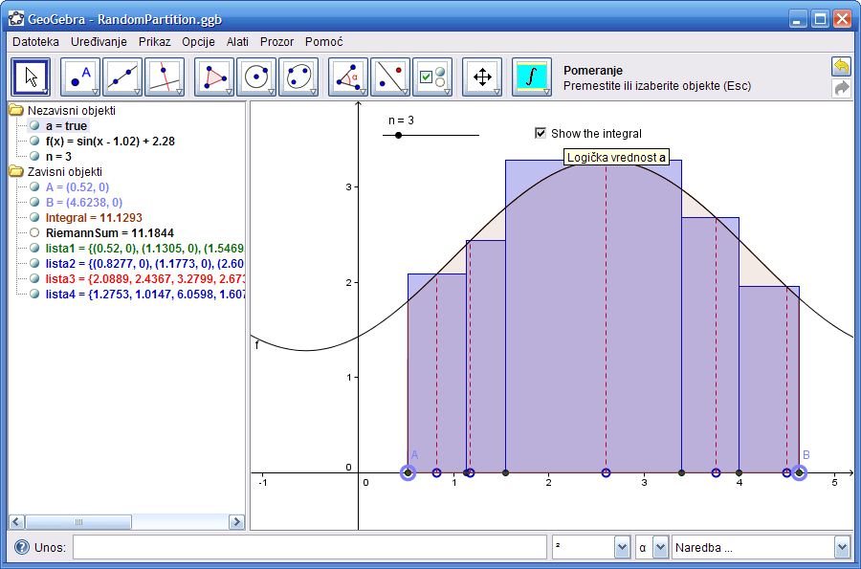
Example 4 – Random partition
Here we introduce more complex tools that produce multiple objects with just one click.

Slide 12
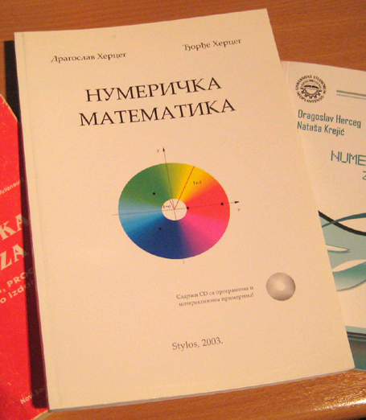
Teaching experience
We taught Numerical analysis to the students of “Jovan Jovanović Zmaj” high school in Novi Sad during school years 2006/07 and 2007/08.
Students divided into two groups each year.
First group was taught in a ‘classical’ way, using Mathematica and GeoGebra applets.
Second group used GeoGebra with our tools and examples. We encouraged the students to use our tools for self-study and homework, too.

Slide 13
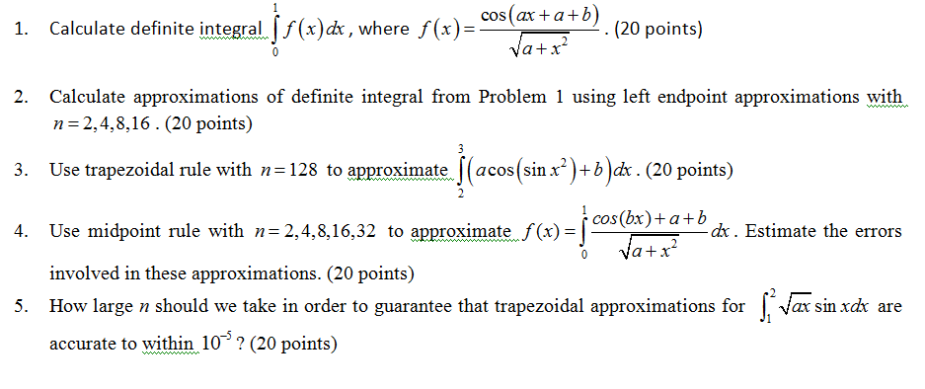
Testing
Both groups of students were given the same tests.

Slide 14
Testing results
* Group 2 used GeoGebra tools for numerical integration

Slide 15
How did we make the tools?
The tools are based on (sometimes) complex compositions of GeoGebra functions.
Equidistant partition of an interval: equiArr = Sequence[x(A) + i (x(B) - x(A)) / n, i, 0, n]
Random partition of an interval: RndPartAux = Sort[Union[Sequence[ (RandomBetween[Element[equiArr, i] 10000, Element[equiArr, i + 1] 10000] / 10000,0), i, 1, Length[equiArr] - 1], {}]]
Rectangles for the visualization of the Riemann sum: RndPart = Sort[Union[ RandomPartitionAux[A, B, n-1], {(x(A),0),(x(B),0)} ]]

Slide 16
What we’d like to have in GeoGebra
Minor bug fixes
For example, Function[Polynomial[...], a, b] should limit the graph of the interpolating polynomial to the interval [a, b], but it does not
For example, Integral[f, a, b] gives both the drawing of the area and a numerical result, but when used from within a tool, the drawing does not appear
Commands to draw complex areas (such as the area obtained by Simpson’s rule)
More advanced command editor with parentheses matching – the input line is very basic, and due to the chosen font, often hard to read, for example, {(x(A),f(x(A))), (x(B),f(x(B)))}
More natural access to array members, i.e. array(i) rather than Element[array, i]

Slide 17
Conclusion
With a little effort, useful tools can be made
Given one tool, almost all students know what to do with it – just a click and you’re done
But when there is a choice, something has to be learned
A tool that a teacher uses for demonstation may not be the best for testing students’ knowledge.
GeoGebra is a great program, based on a great idea

